Slide 1
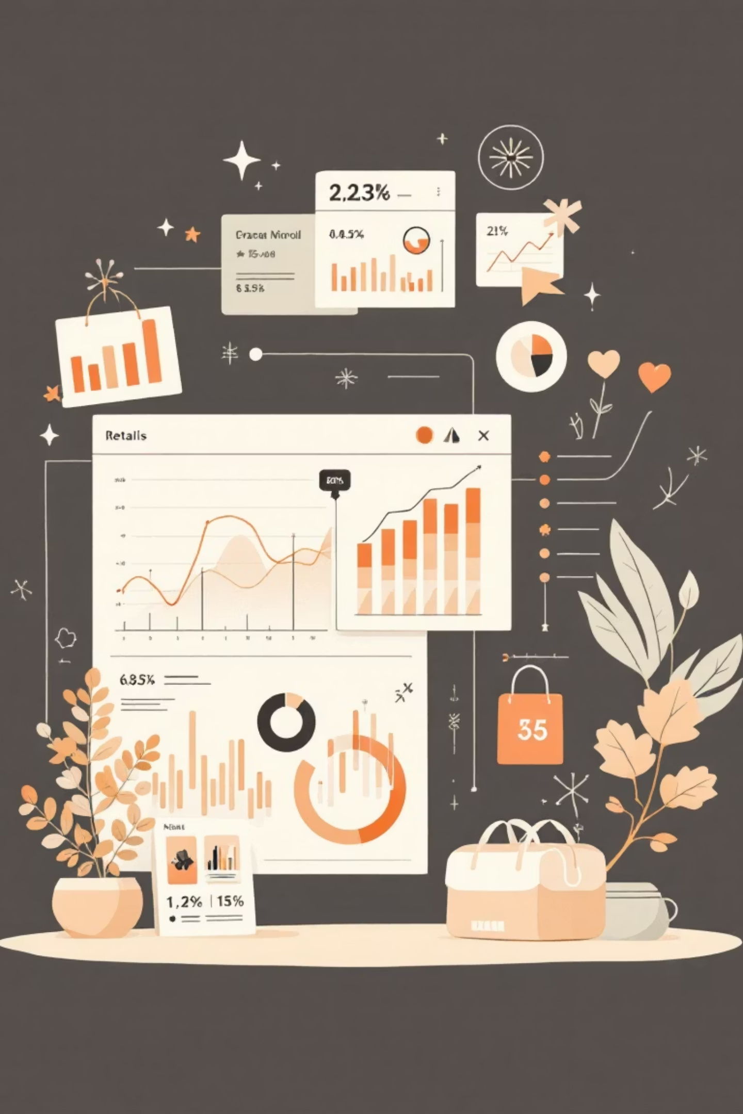
Customer Shopping Behavior Analysis
Analyzing 3,900 purchases to uncover insights into spending patterns, customer segments, and product preferences that drive strategic business decisions.

Slide 2
Dataset Overview
3,900
18
37
Total Purchases
Data Features
Missing Values
Transactions analyzed across various product categories
Columns capturing demographics, purchases, and behavior
Found only in Review Rating column
Key features include customer demographics (Age, Gender, Location, Subscription Status), purchase details (Item, Category, Amount, Season, Size, Color), and shopping behavior (Discounts, Previous Purchases, Frequency, Review Rating, Shipping Type).

Slide 3

Data Preparation in Python
Data Cleaning Steps
Feature Engineering
Loaded dataset using pandas
Created age_group by binning customer ages
Explored structure with df.info() and .describe()
Generated purchase_frequency_days from purchase data
Imputed missing Review Ratings using median by category
Integrated cleaned data into PostgreSQL for SQL analysis
Standardized columns to snake_case
Dropped redundant promo_code_used column

Slide 4

Revenue Analysis by Gender
Compared total revenue generated by male versus female customers to understand gender-based spending patterns and inform targeted marketing strategies.
Male Customers
Female Customers
Revenue contribution and average purchase behavior
Revenue contribution and average purchase behavior

Slide 5

Key SQL Analysis Insights
01
02
High-Spending Discount Users
Top 5 Products by Rating
Identified customers using discounts but spending above average
Found products with highest average review ratings
03
04
Shipping Type Comparison
Subscribers vs. Non-Subscribers
Compared average purchase amounts between Standard and Express
Analyzed average spend and total revenue by subscription status

Slide 6
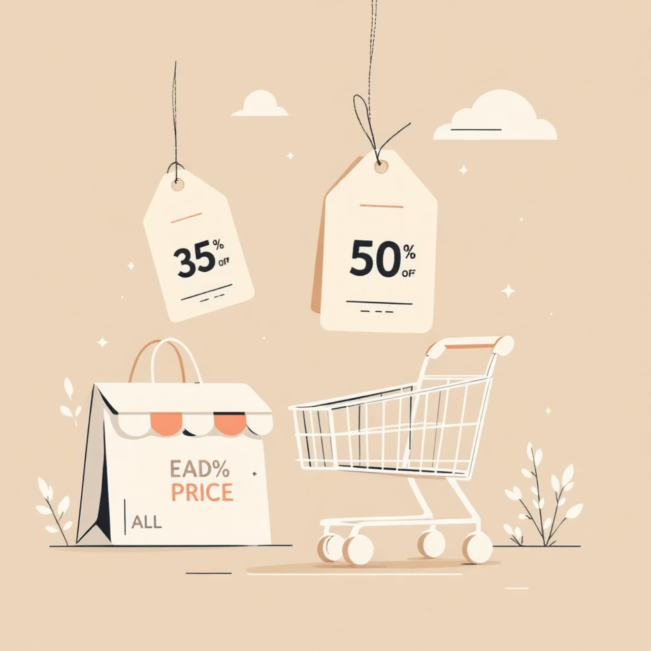
Product & Discount Analysis
Discount-Dependent Products
Identified 5 products with the highest percentage of discounted purchases, revealing which items rely most heavily on promotions to drive sales.
Top Products per Category
Listed the most purchased products within each category to understand customer preferences and optimize inventory.

Slide 7




Customer Segmentation
New Customers
First-time buyers entering the ecosystem
Returning Customers
Repeat purchasers showing engagement
Loyal Customers
High-frequency buyers with strong brand affinity
Classified customers based on purchase history to tailor retention strategies. Analysis showed customers with >5 purchases are significantly more likely to subscribe.

Slide 8
Revenue by Age Group
Calculated total revenue contribution of each age group to identify high-value demographics and optimize marketing spend.
18-30 Years
31-45 Years
Young adults with emerging purchasing power
Prime earning demographic with highest spend
46-60 Years
60+ Years
Established customers with consistent behavior
Senior segment with specific preferences

Slide 9
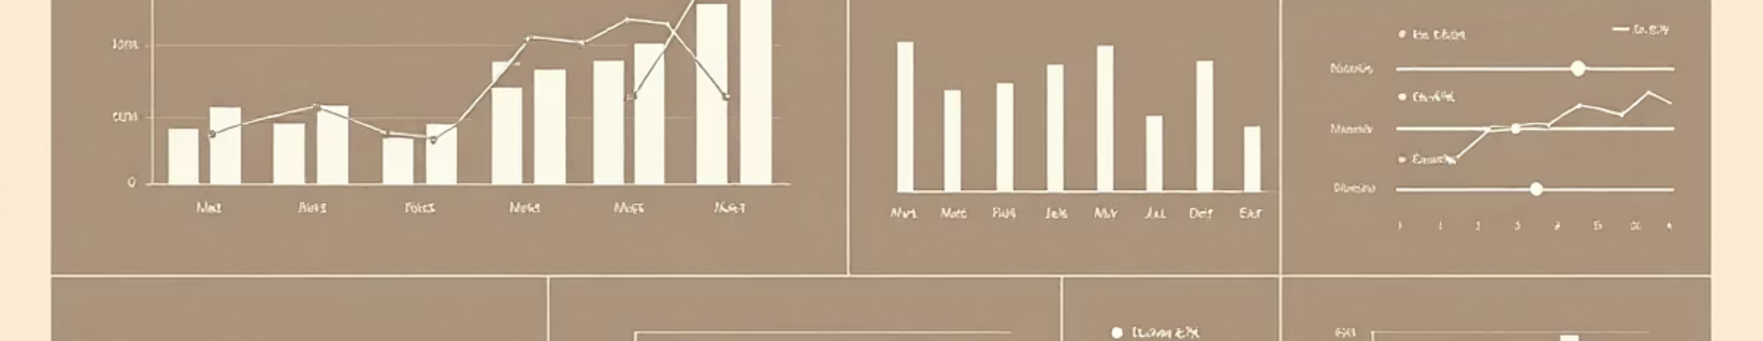

Interactive Power BI Dashboard
Built an interactive dashboard in Power BI to present insights visually, enabling stakeholders to explore data dynamically and make informed decisions in real-time.
Visual Analytics
Dynamic Filtering
Real-Time Insights
Interactive charts showing revenue trends and patterns
Slice data by demographics, products, and time periods
Instant access to key metrics and performance indicators

Slide 10
Strategic Recommendations
Boost Subscriptions
Loyalty Programs
Review Discount Policy
Promote exclusive benefits for subscribers to increase recurring revenue
Reward repeat buyers to move them into the "Loyal" segment
Balance sales boosts with margin control for profitability
Product Positioning
Targeted Marketing
Highlight top-rated and best-selling products in campaigns
Focus efforts on high-revenue age groups and express-shipping users

